Slide 1
By: Jovy Ann Nelson and Loc Hoang
WINDBAY
ONLINE MARKETPLACE

Slide 2
DATABASE REQUIREMENTS
Have a minimum of 6 entities
Crows feet notation must be used
Cardinality must be defined, including relationship and attributes minimums and maximums
Unique values should be indicated for Attributes
Documentation which are Strong and weak entities, including any Supertype and Subtype entities.
IN ADDITION:
List which products we currently have in inventory
Create new products
Modify the amount of a particular product that we have in inventory
Delete a product from inventory
Get a list of the most popular products for a given time range.
Get a list of the least popular products for a given time range.
Get a list of users who haven’t purchased something in a few months to send promotional emails to
Send them promotional item of items they bought in the past.
EXTRA CREDIT: To send top 5 most popular items as promotional email to buyers who has not purchased any products.

Slide 3

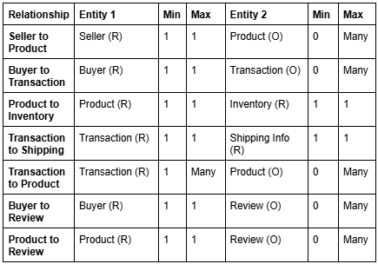
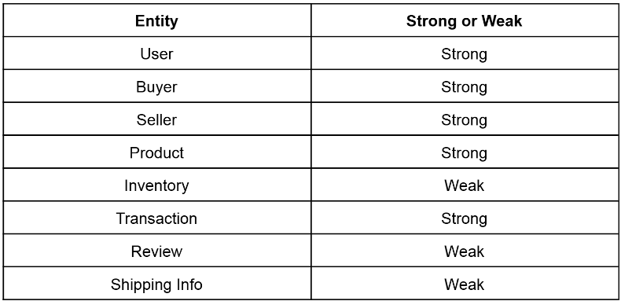
ANALYSIS PHASE
Entities:
User
Review
Transaction
Product
Inventory
Shipping Info
Supertype and Subtypes:
Supertype: User
Subtypes: Seller and Buyer
Strong and Weak Entities
Cardinality:

Slide 4
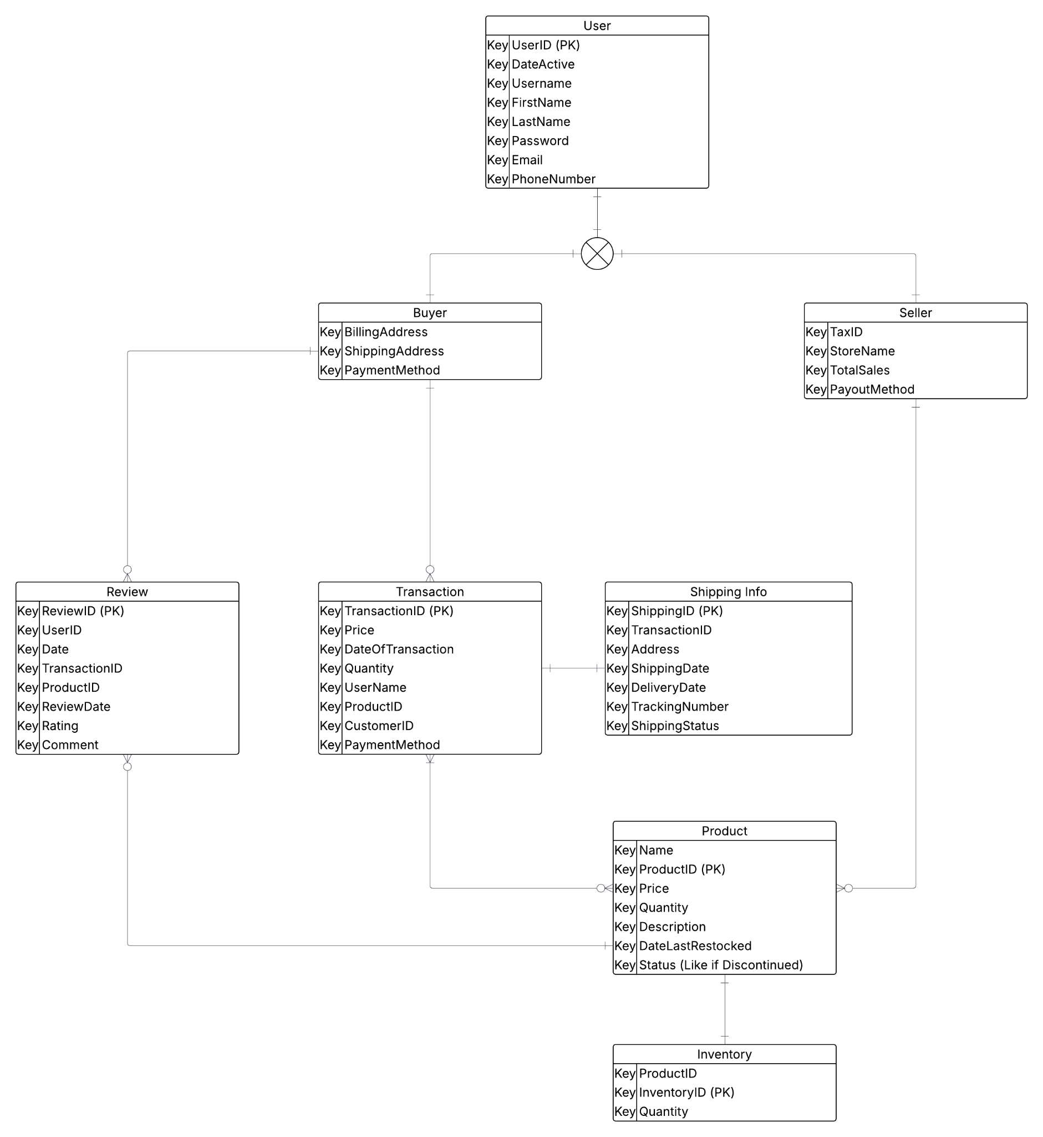
UNNORMALIZED AND NORMALIZED MODEL

Slide 5
DATABASE DESIGN FROM THE ERD
Supertype
ENTITIES: User, Review, Transaction, Shipping Info, Product, and Inventory
ATTRIBUTES: Date, Price, Address, etc.
Subtype
Subtype
WindBay ERD
RELATIONSHIPS:
Buyer > Review
Buyer > Transaction
Transaction > Product
Transaction > Shipping
Seller > Product
Product > Inventory

Slide 6
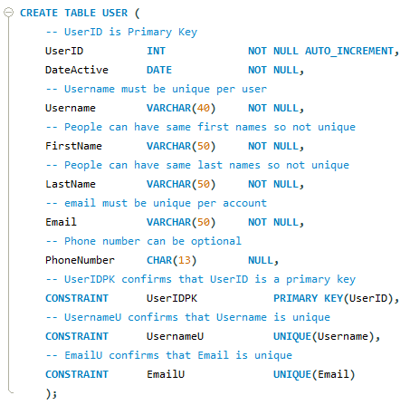
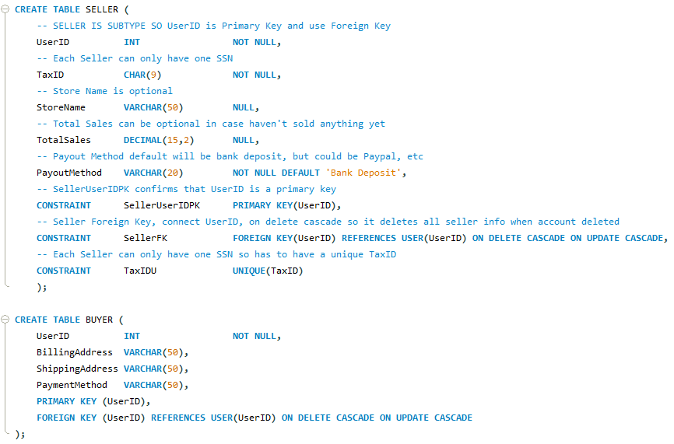
WINDBAY DATABASE DESIGN
USER (Supertype)
SELLER & BUYER (Subtypes)
Subtype
Users can either be a buyer or seller but not both!

Slide 7
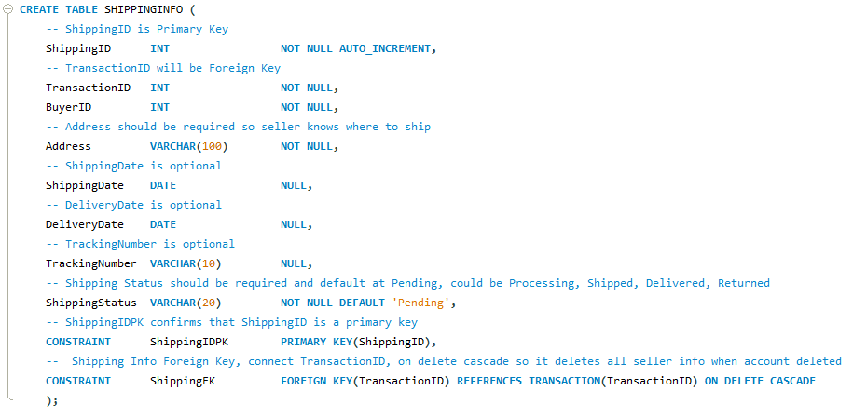
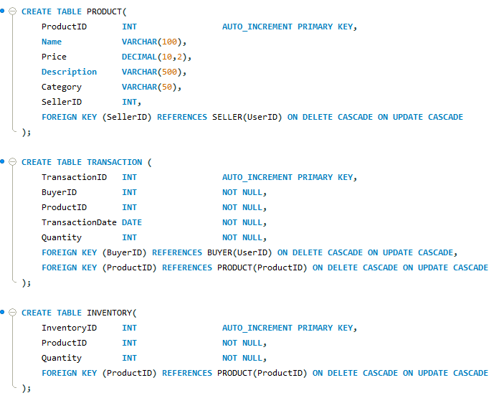
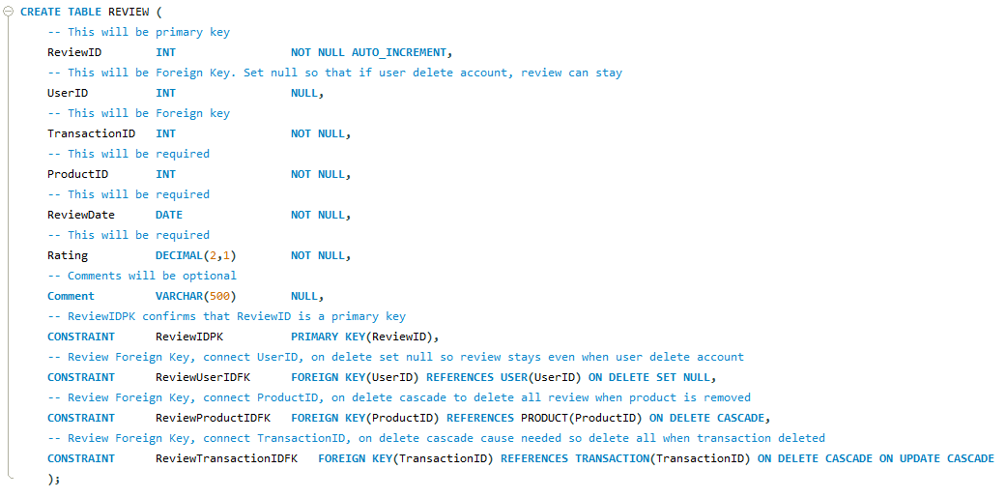
WINDBAY DATABASE DESIGN
Database Tables

Slide 8
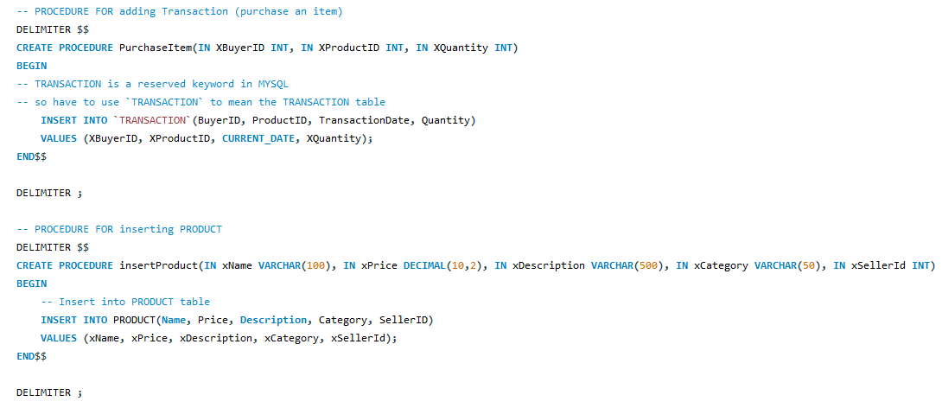
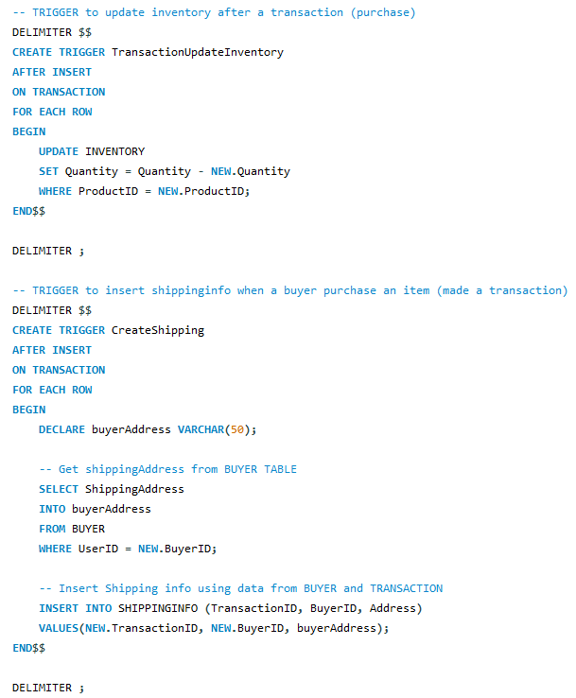

PROCEDURES & TRIGGERS
PROCEDURE:
TRIGGER:

Slide 9
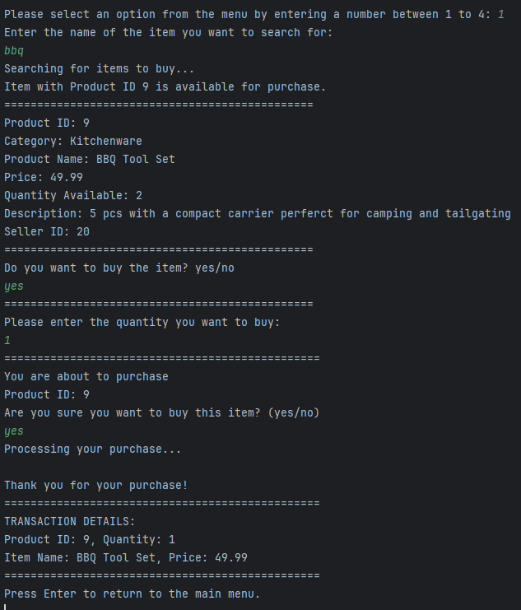
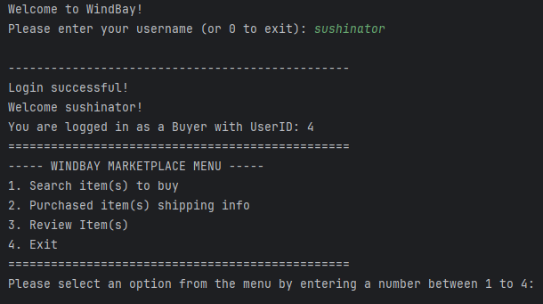
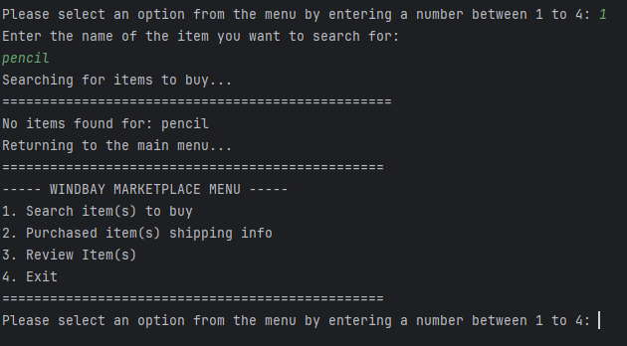
DEMO as a BUYER
Search item(s) to buy:
BUYER DASHBOARD:
<- Invalid Item Search

Slide 10
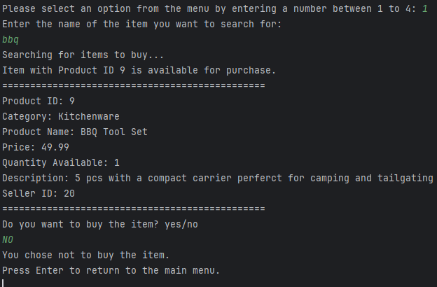
DEMO as a BUYER
QUANTITY Available changed because of Trigger!
BEFORE TRANSACTION:

Slide 11
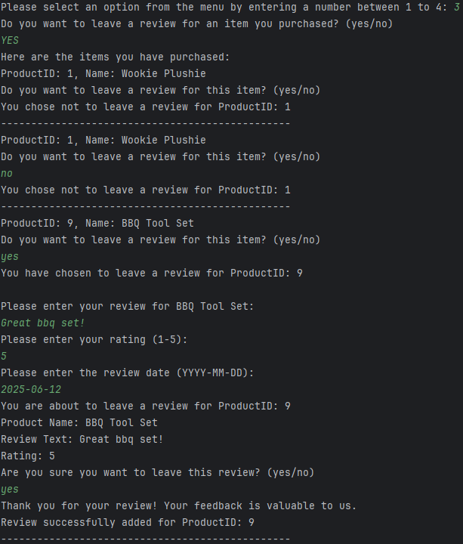
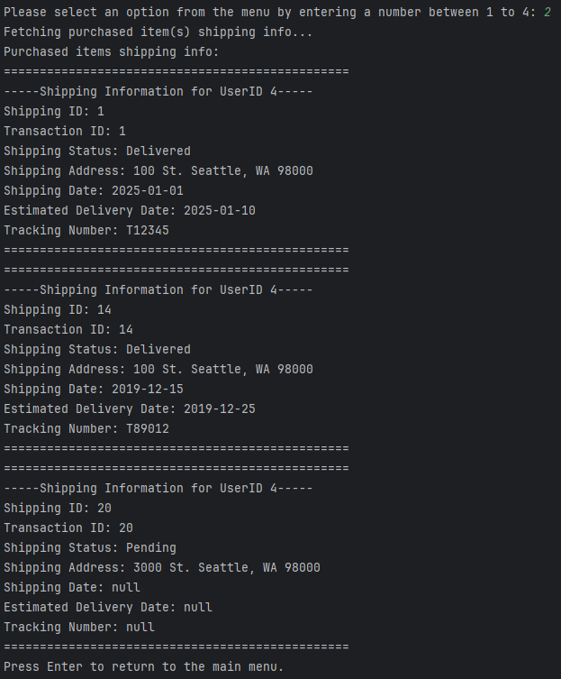
DEMO as a BUYER
Leaving a review:
Shipping Info:

Slide 12
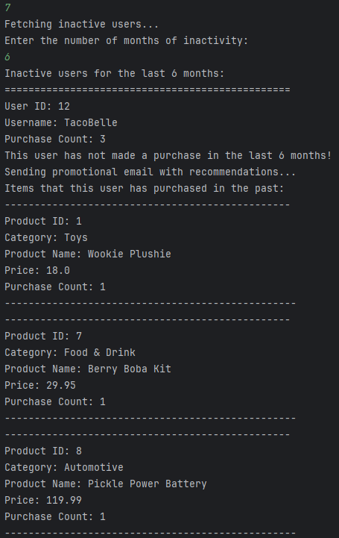
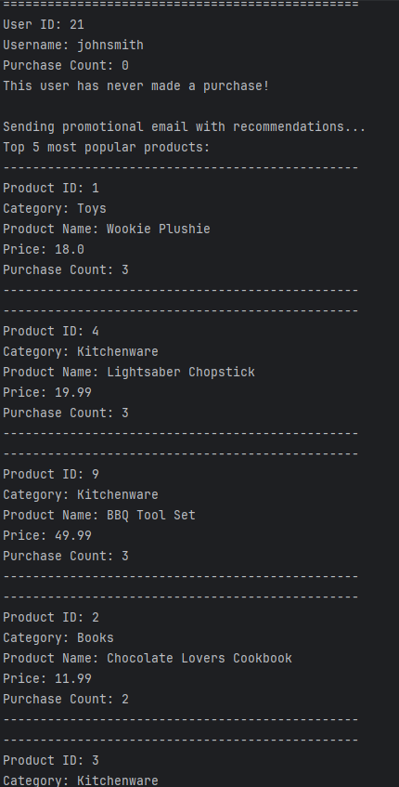
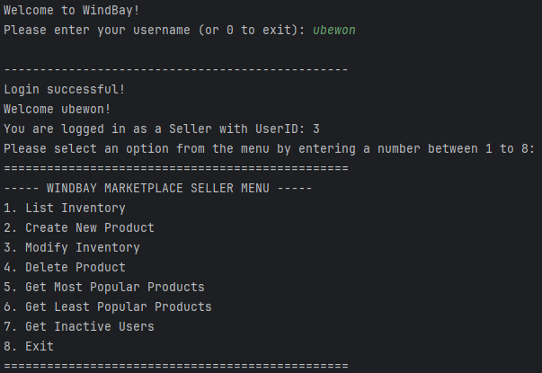
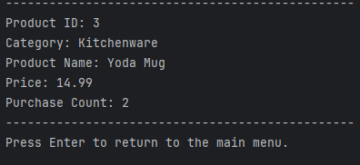
DEMO as a SELLER
INACTIVE USERS Promotional Email
SELLER DASHBOARD:

Slide 13


WINDBAY DEMO

Slide 14
ANY QUESTIONS?
Thank You!

